Slide 1

TEAM ID : 33
Vyas Mihir Hitesh
Dhruv Vyas
Bhavika Chhatbar
Jay Joshi

Slide 2
The Hackathon is organized by the B H Gardi College. The Hackathon is linked to the design thinking and SDGs “ICT for Development”

Slide 3

Challenge Areas Please choose of the following challenge categories for which your team will develop a proof of concept.
For more information on the challenge areas visit Themes

Slide 4
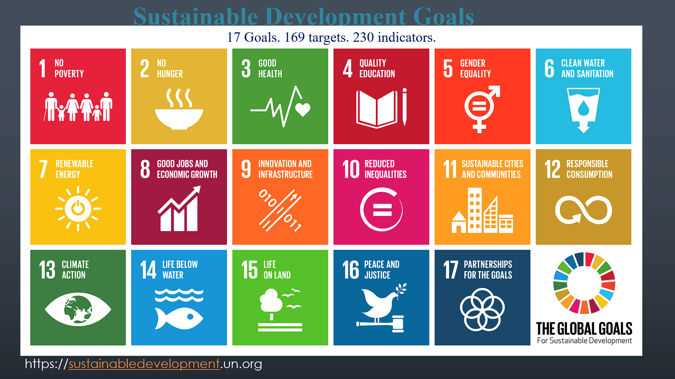
Problem to be solved
Analyzing gender specific healthcare data to identify disparities, develop predictive model and propose gender sensitive intervention to address inequalities in healthcare aligning with SDGs 3 and 5.

Slide 5

Disparities
In healthcare
Access to preventive care
Chronic disease management
Mental healthcare
In Maternal care
Prenatal care
Access to skilled birth attendants
Access to emergency obstetric care
Cultural norms

Slide 6
Causes of disparity
Poverty
Lack of health insurance
Gender bias
Stigma around women's health
Early marriage and child bearing
Lack of education
Lack of female providers
Limited healthcare infrastructure
Transportation limitations

Slide 7
Current gaps
Lack of data integration
Limited analysis
Narrow approach of intervention
Lack of scalability
Limited evaluation

Slide 8
Objectives
Data collection and preparation
Data exploration and analysis
Understanding data characteristics
Healthcare dataset quantity
Identification of inconsistencies and missing values
Identify patterns and trends
Disease prevalence
Healthcare utilization rate
Generative hypothesis
Informing decision making
Cont..

Slide 9
Objectives
Visualizing disease prevalence
Graphical representation
Statistics
Charts
Graphs
Analyzing Healthcare utilization rates
Exploring demographic trends
Using demographic variables such as age, gender, ethnicity, etc
Cont..

Slide 10
Objectives
Temporal analysis
Identify seasonal patterns and long term trends
Geospatial analysis
Identification of regions with high disease burden or disparities
Identify outliers and anomalies
Investigate potential data errors or unusual patterns

Slide 11
Our Solution : Data analytics
Collecting data
Data preprocessing
Exploratory Data Analysis (EDA)
Feature selection
Model development using ML
Predictive modelling
Model evaluation and validation
Deployment and Integration

Slide 12
Datasets for predictive modelling
Public health data
National and local health surveys
Hospital discharge data
Birth certificate and pregnancy outcome data
Socioeconomic data
Census data
Social security administration data
Behavioral and attitudinal data
Health knowledge and awareness surveys
Cultural norms and beliefs surveys

Slide 13
Outcomes of predictive modelling
For example..
Identify women at high risk of inadequate prenatal care or complications during childbirth.
Predict areas with high prevalence of gender disparities in chronic disease management.
Recommend targeted interventions based on a woman's specific needs and socio-demographic context.

Slide 14

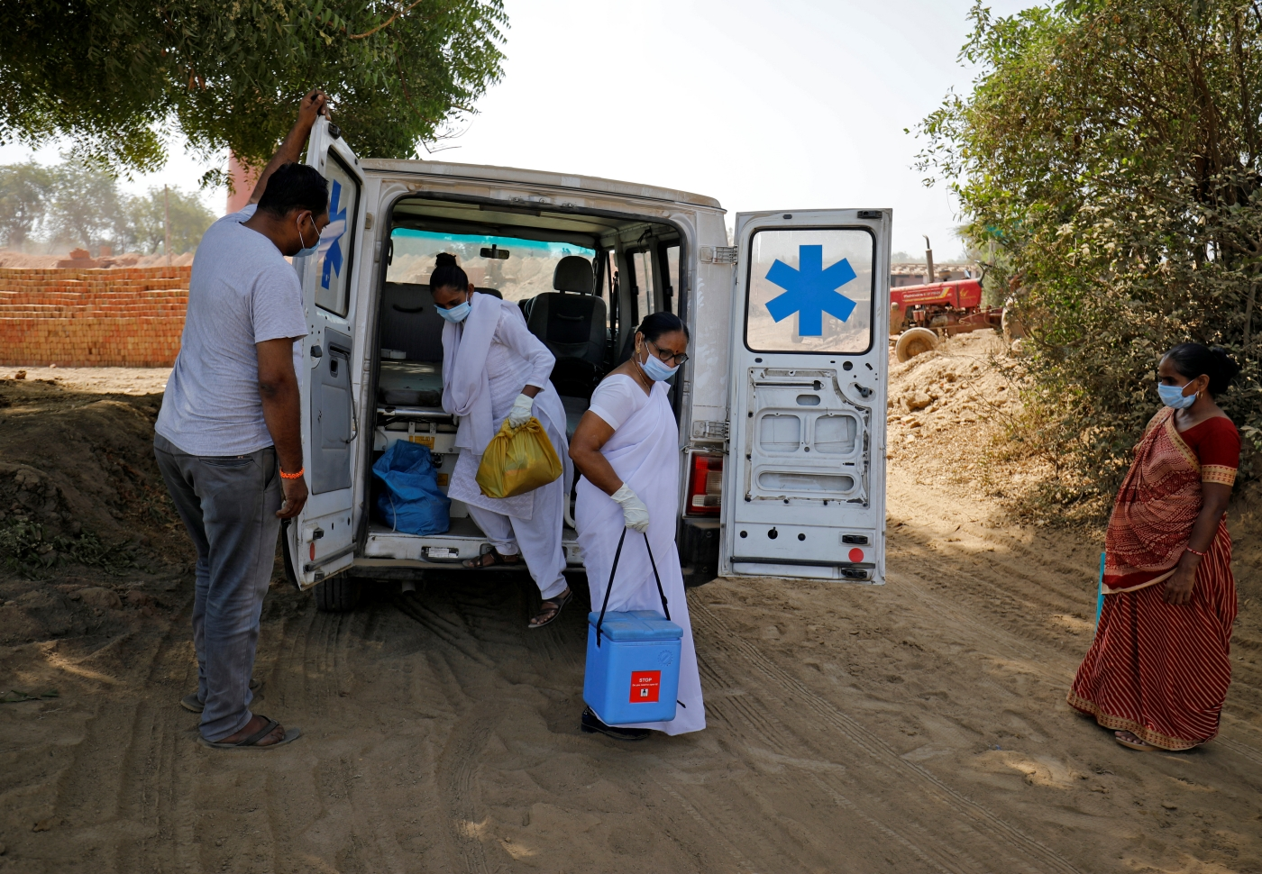
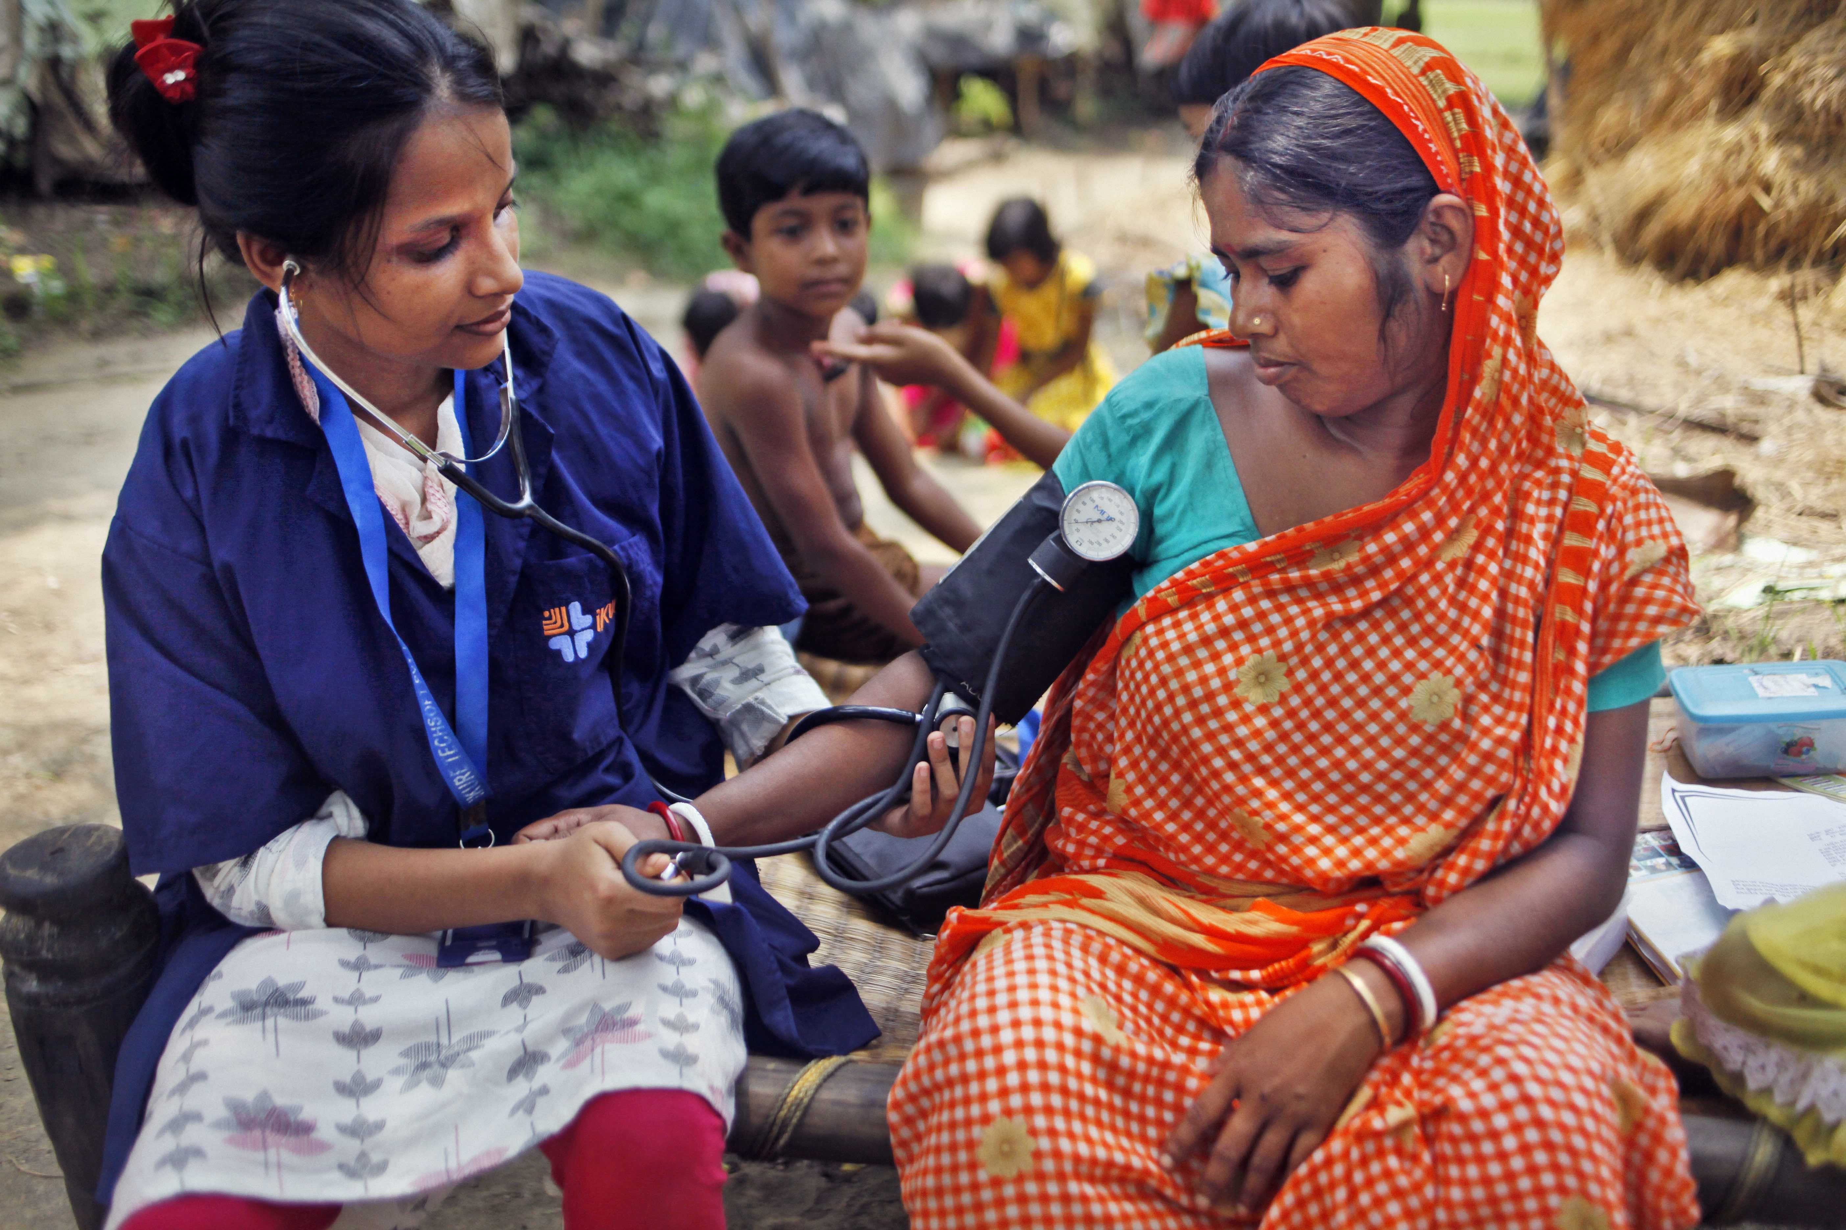
Rural reachability

Slide 15
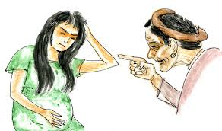

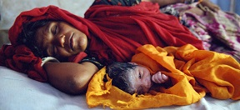
Societal norms and taboo followings
Dietary restrictions
Social Isolation
Physical activity
Menstrual seclusion
Restrictions on religious activity
Social isolation

Slide 16
Proposed interventions
Public health campaigns
Financial assistance programs
Gender sensitization training

Slide 17
Will be implemented on
Health Ministry level
Ground level

Slide 18
Ground level
Instant hospital and clinic healthcare data updation
Quick Virtual Medical Assistance
Spontaneous Emergency Services
ABHA Registration and Authentication

Slide 19
Health Ministry level
Gathering Healthcare data and its Analysis
Providing Evidence-based proposed interventions
Visualization through Geomaps, HEATmaps, Graphs, etc.

Slide 20
Dataset
Name
Age
Gender
BMI
Blood Pressure
Healthcare outcomes

Slide 21
Selecting two columns
BMI
Healthcare outcomes
Feature column
Targeted column

Slide 22
Sample
Size
No. of subset
Cross validation
Data sampling

Slide 23
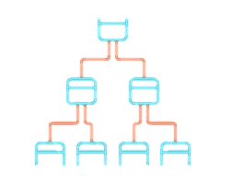
Sampled data
TEST & SCORE
Machine Learning Algorithm
Trained Model

Slide 24
Solution Snapshots
Followed by code

Slide 25
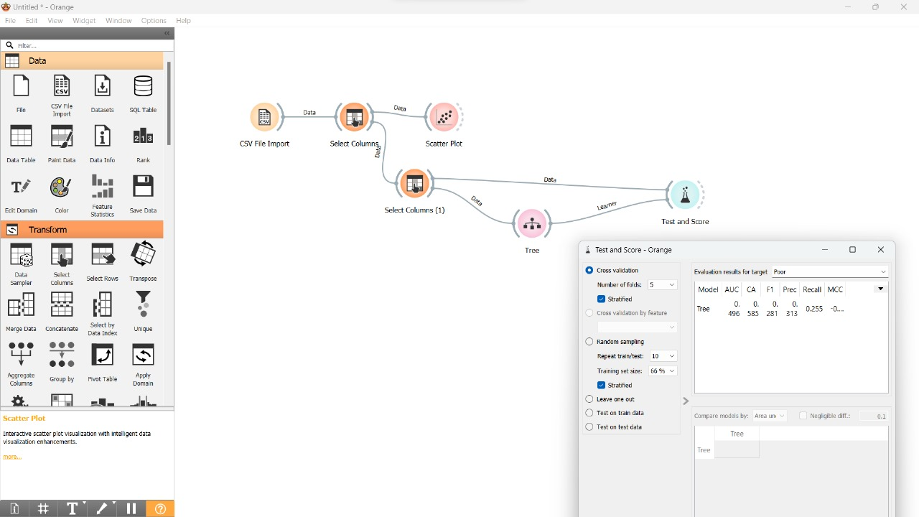

Slide 26
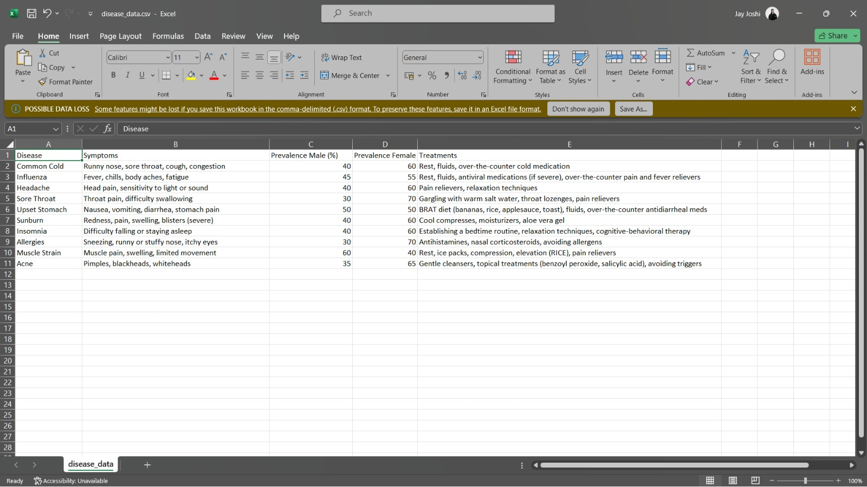

Slide 27
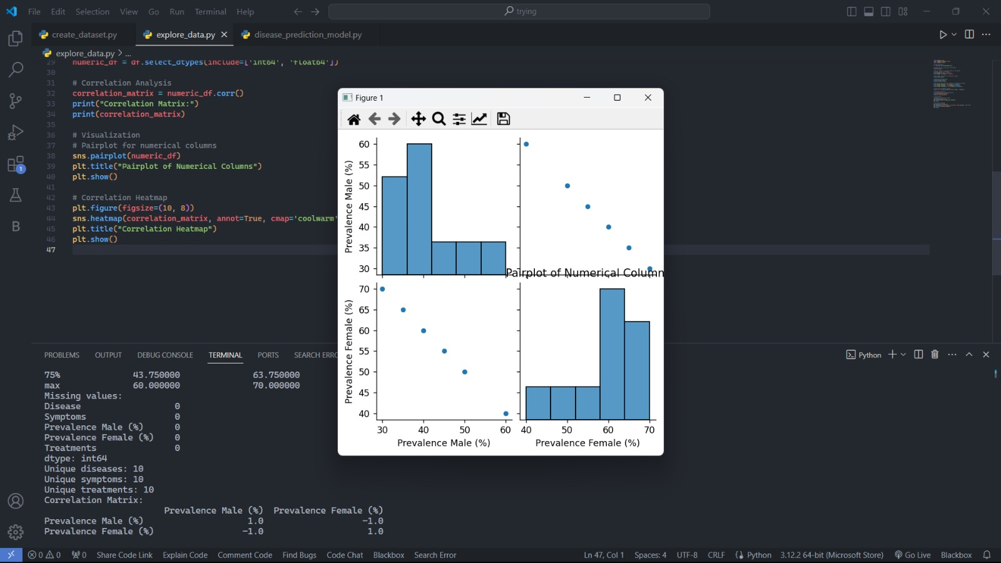

Slide 28
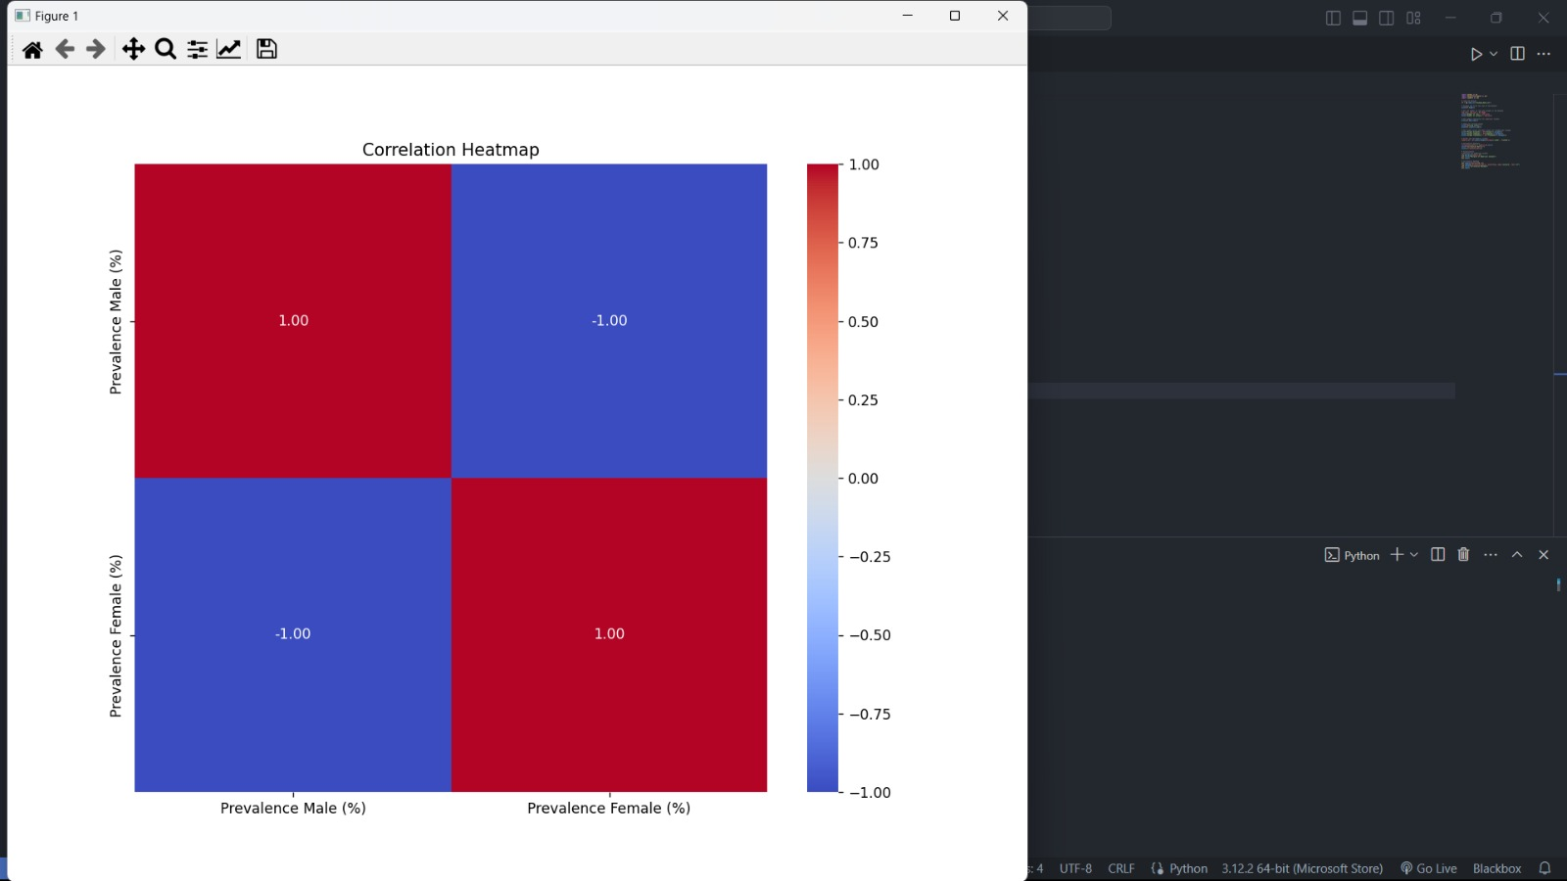

Slide 29
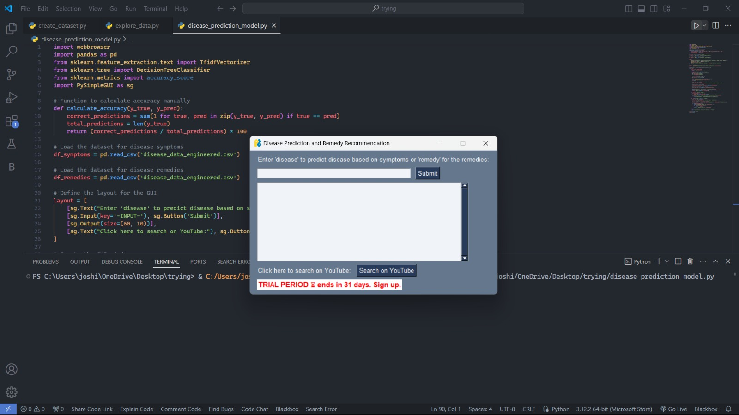

Slide 30
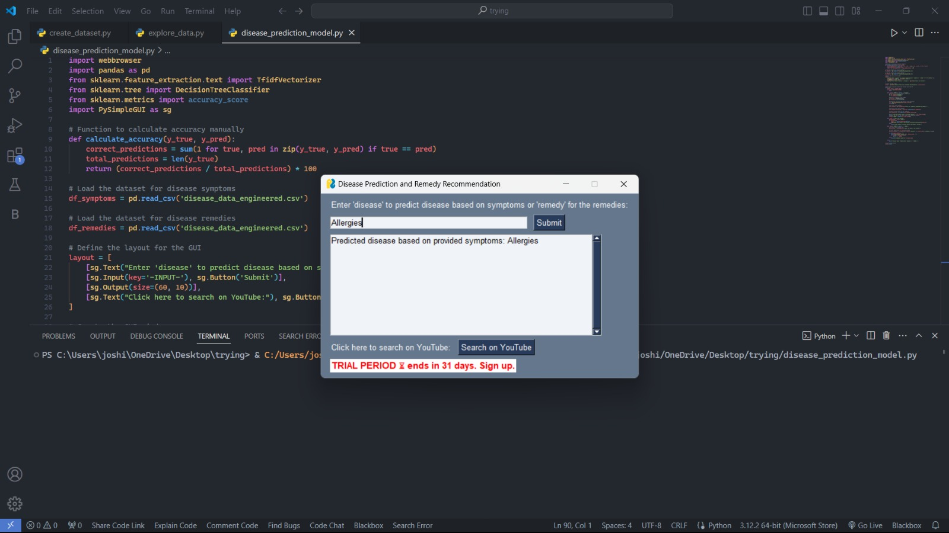

Slide 31
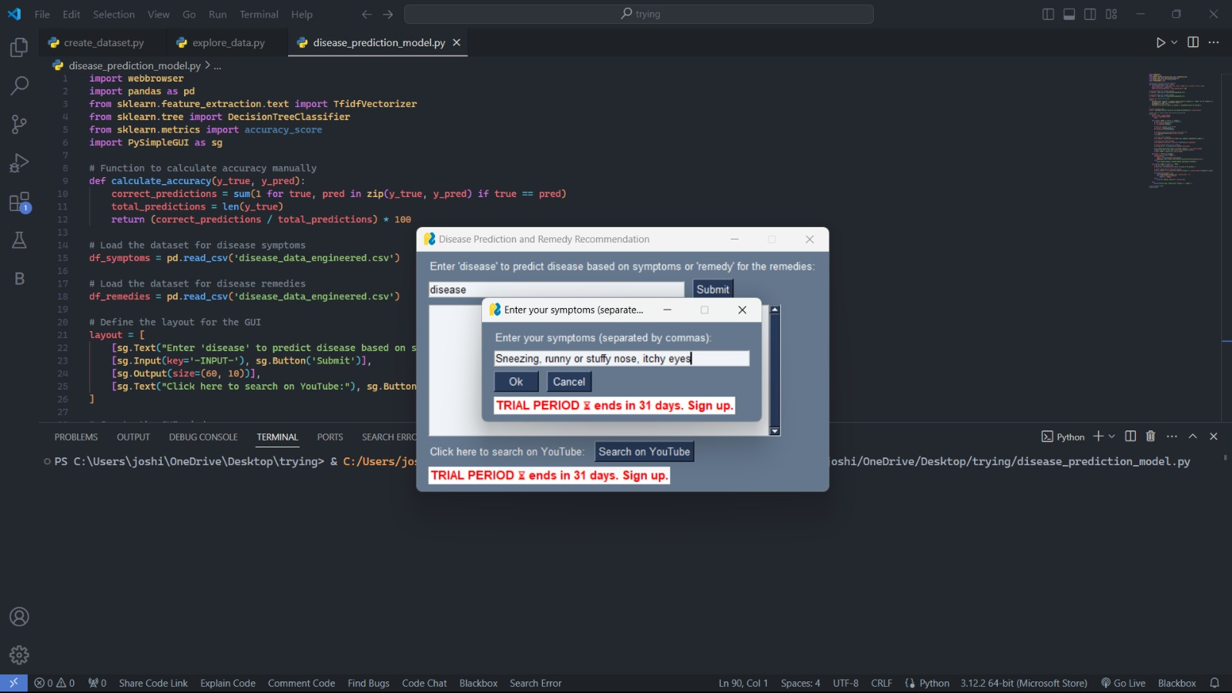

Slide 32
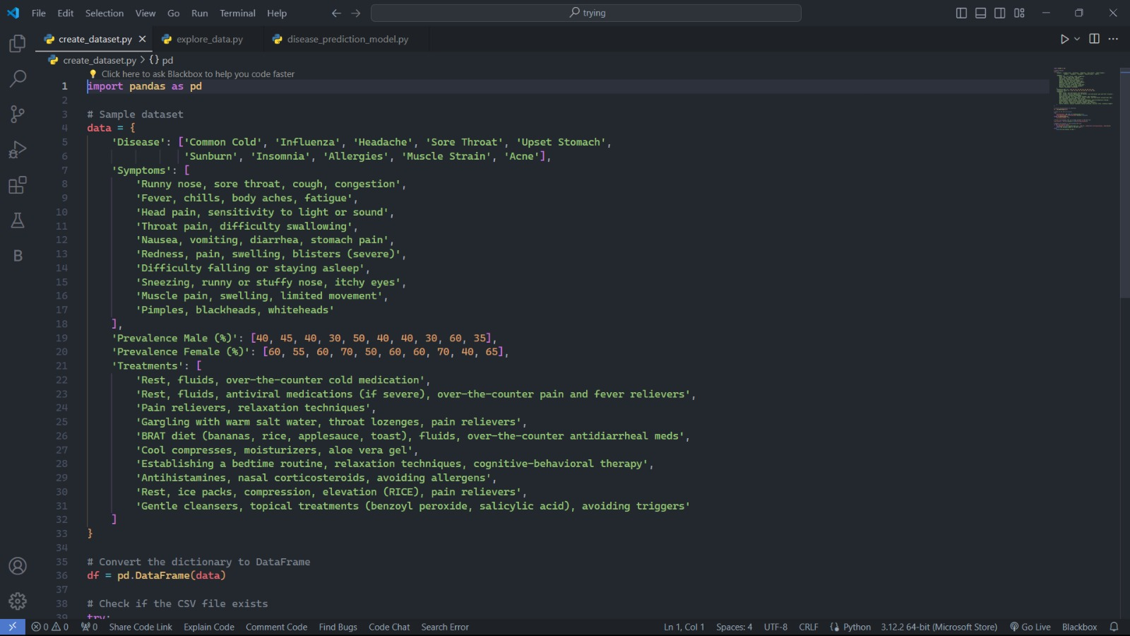

Slide 33
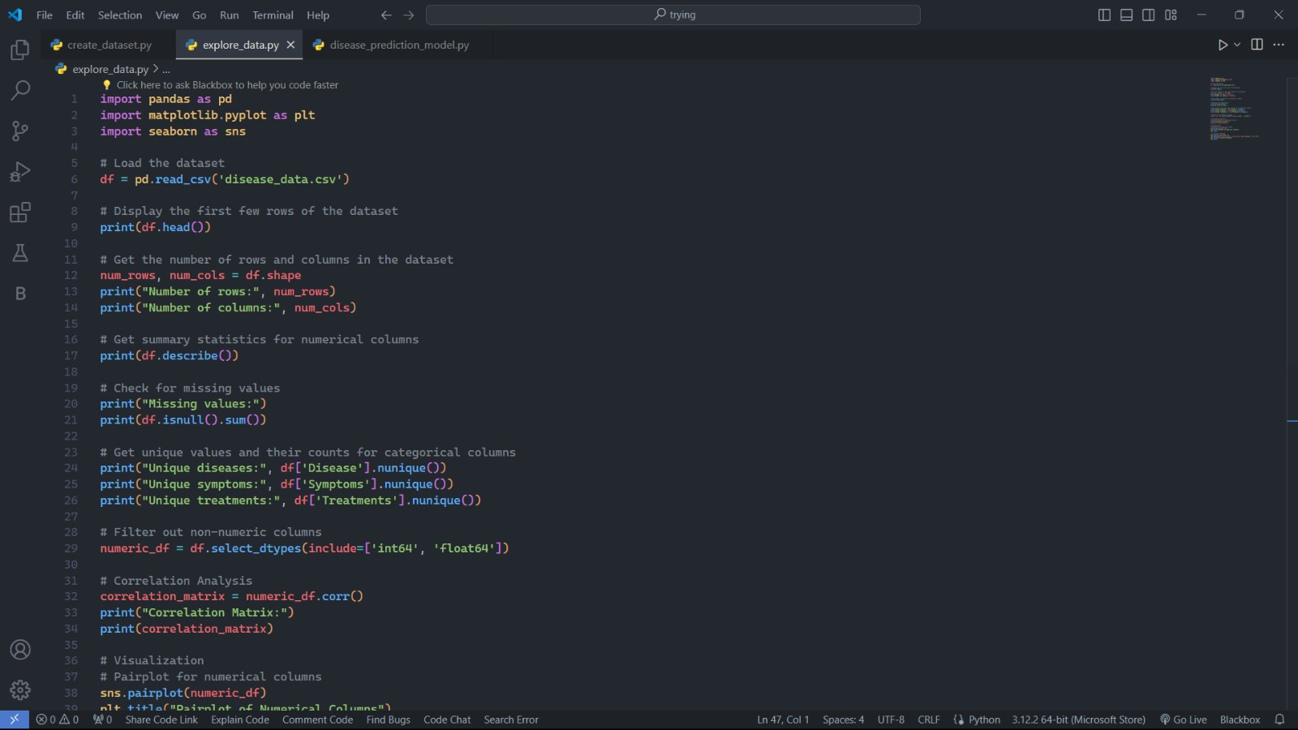

Slide 34
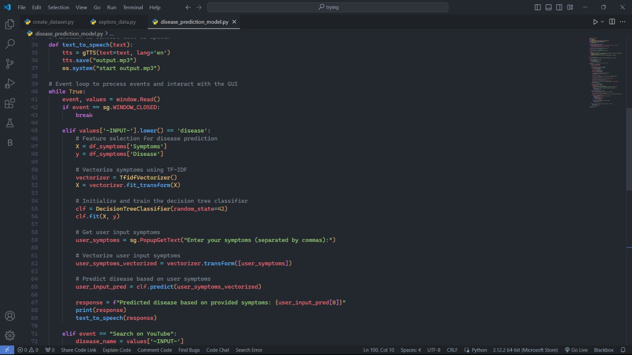

Slide 35
Thank You

